Slide 1
Bank Management System
Submitted By
Vishal Rai
21MCA2443

Slide 2
Contents
Aim
Problem Description
Benefits
Language Used : C++
Modules
Conclusion

Slide 3
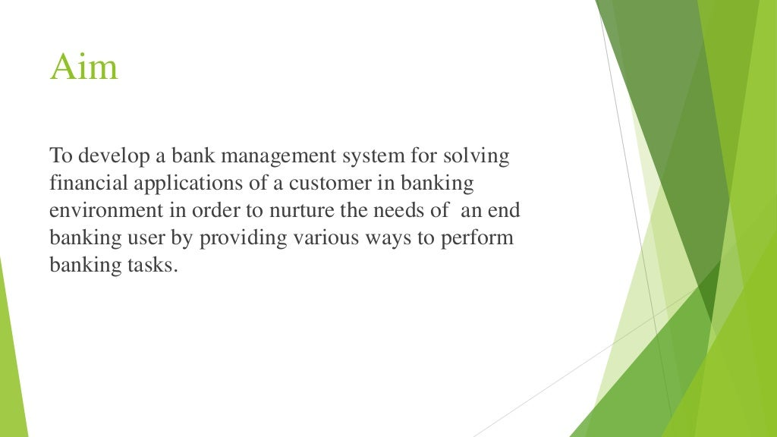

Slide 4
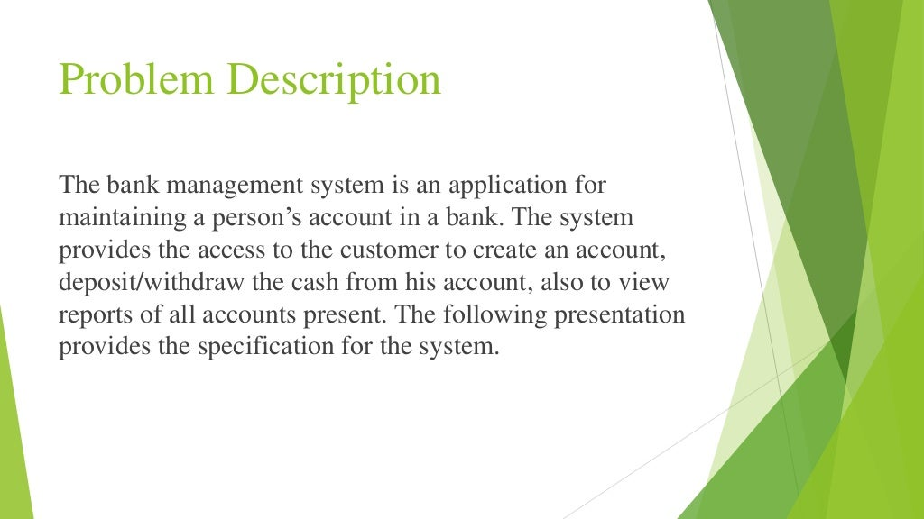

Slide 5


Slide 6
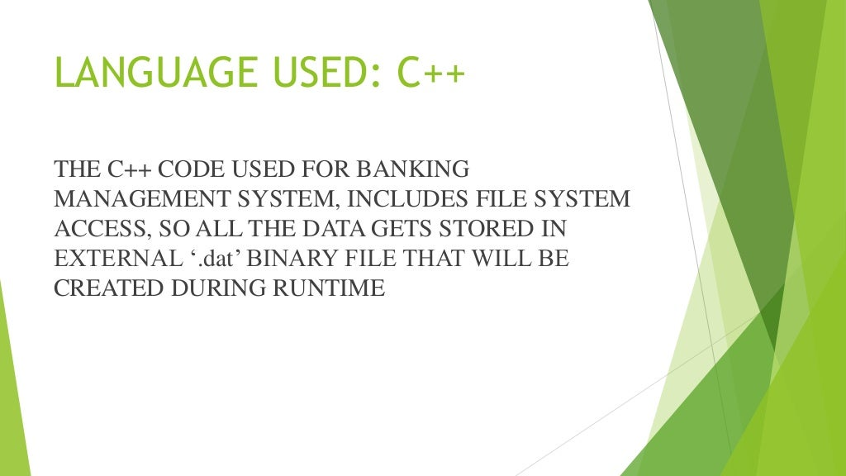

Slide 7
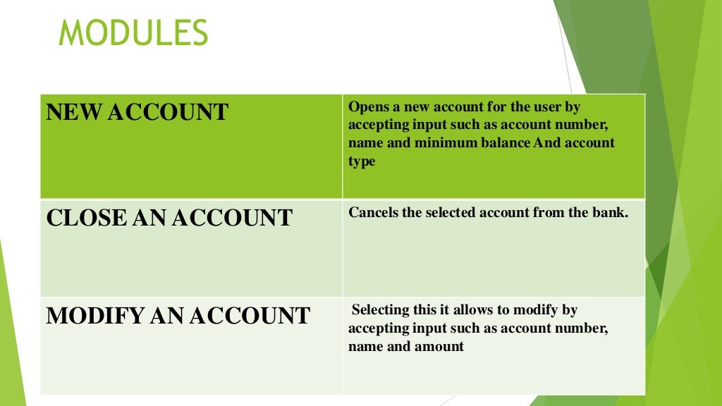

Slide 8
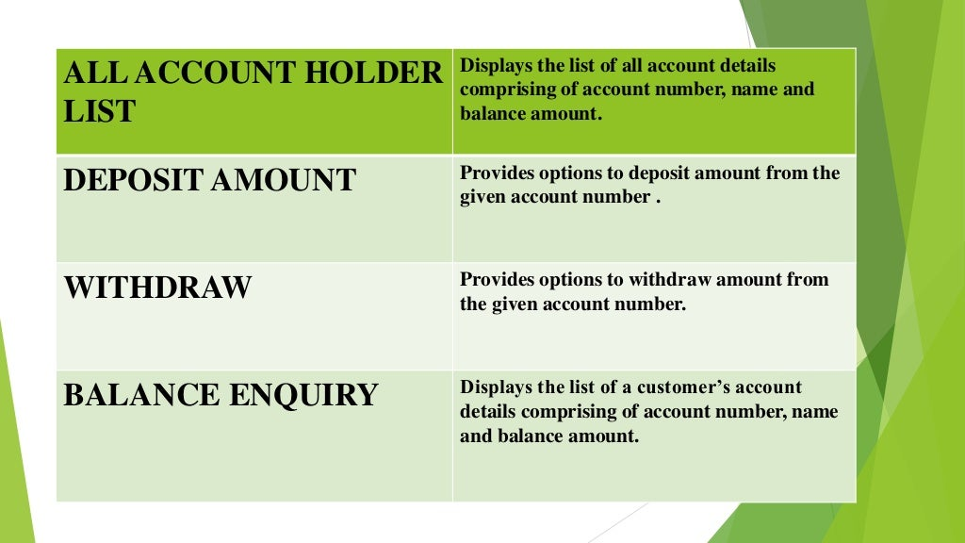

Slide 9
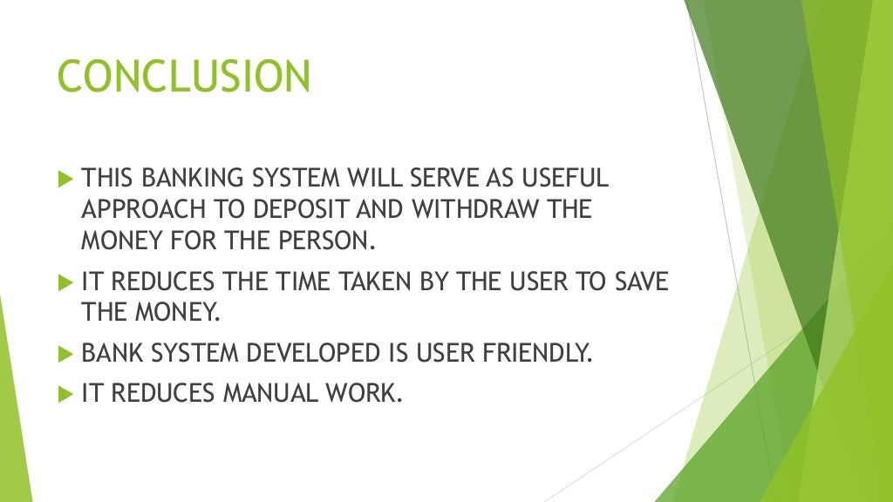

Slide 10


